Slide 1
Monthly Update on 2018-2019 WRAP Workplan February 27th, 2019 TSC and Work Group Co-Chairs Call
Tribal Data WG
Fire and Smoke WG
Oil and Gas WG
Regional Technical Operations WG
Regional Haze Planning WG

Slide 2
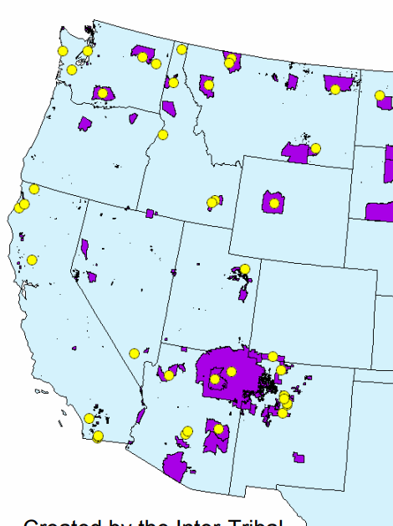
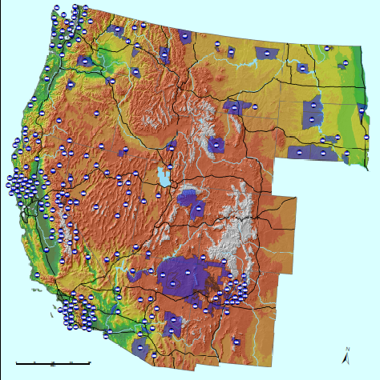
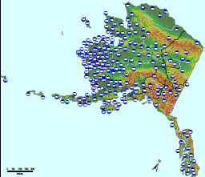
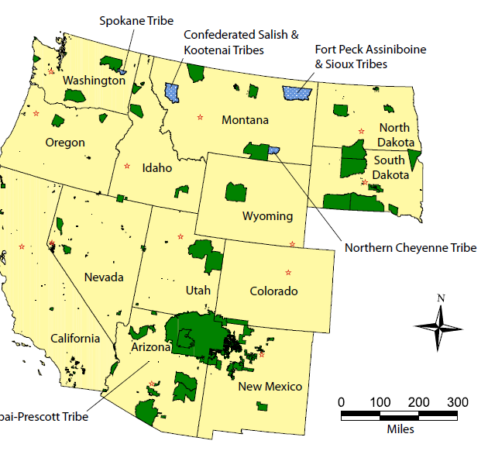
Tribal Data Work Group

Slide 3
Workplan Progress by Tribal Data Work Group
Workplan Progress over the Last Month
Factsheets, presentations completed.
WRAP area Tribal/Environmental contact list – complete save R10
Tribal Maps updated and reflected on WRAP main page map
Oil and Gas report complete; contractor coordination with workgroups in progress
Consultation and Coordination Protocol document, next attempt
Workplan Tasks for the Next Two Months
Complete finalization by consensus of products under contract
Prepare for webinars and National Tribal Forum on Air Quality

Slide 4
Workplan Coordination Activities by Tribal Data Work Group
Workplan Coordination Occurring over the Last Month
Consultation & Coordination (C&C) Subcommittee – ITEP/EN3 work under agreement for TDWG paused until future product procured through RHPWG contractor is drafted. Goal: product/s that fit into framework document and schedule; scheduling of webinars
Oil and Gas Workgroup – ITEP, EN3 and TDWG drafted Tribal oil and gas related emissions
Workplan Coordination Needed over the Next Two Months
Same groups as mentioned above
EPA/NTAA/ITEP National Tribal Forum on Air Quality – breakout session and networking or tabling
WRAP area Tribal contact list – complete R10

Slide 5
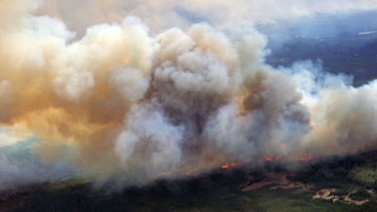
and
Fire and Smoke Work Group

Slide 6
Workplan Progress by Fire and Smoke Work Group
Workplan Progress over the Last Month
No new workplan updates for Round 2
Josh Hall withdrew as co-chair; he got a new job
Bob Kotchenruther (EPA Region 10) agreed to step in as co-chair; negotiating for a 3rd co-chair
Convened the Representative Baseline and Future Fire Scenarios working group (RBFFS): had kick-off call, Matt Mavko briefed the group
Workplan Tasks for the Next Two Months
Identify and implement methodologies to determine future year and multi-year baseline fire emissions for RH modeling: this is RBFFS’ main task
RBFFS next call scheduled for March 6, will meet fortnightly

Slide 7
Workplan Coordination Activities by Fire and Smoke Work Group
Workplan Coordination Occurring over the Last Month
Member overlap between RBFFS and EIMP Subcommittee and RHWG
Workplan Coordination Needed over the Next Two Months
Need to coordinate with Emissions Inventory and Modeling Protocol Subcommittee and RTOWG on preparing the baseline and future year fire EIs
Currently coordinating with members of EIMP subcommittee
Will coordinate with RTOWG when we get to Task 3 of RBFFS scope (Evaluate existing plume rise methods and recommend approaches for model implementation and sensitivity analyses)

Slide 8
Oil and Gas Work Group

Slide 9
Workplan Progress by Oil and Gas Work Group
Workplan Progress over the Last Month
OGWG Survey deliverables for O&G operator distribution by State Agencies
OGWG Workplan Review & Update approved by consensus on Feb. 12 call and provided to TSC
Workplan Tasks for the Next Two Months
OGWG O&G Operator Surveys – Mid-March - Completion
Task 1: Base Year Inventory – Mid-March- Survey compilation memo
Task 2: Forecast 2028 Inventory (On-the-books controls) – Late-February/Early-March - Forecast scenarios

Slide 10
Workplan Coordination Activities by OGWG
Workplan Coordination Occurring over the Last Month
February 12 – OGWG Bi-Monthly Call
TDWG Contractor (EN3) Presentation – ITEP Task 1.4
Assistance from Agencies/O&G operators to complete OGWG Survey
Workplan Coordination Needed over the Next Two Months
March 4 – Project Management Team Call
Discuss steps to wrap-up the survey effort with Ramboll.
Coordinate on the forecast scenarios and provide PMT feedback to Ramboll.
April 9 OGWG Bi-Monthly Call
Agenda under development
Assistance from remaining Agencies/O&G operators to complete OGWG Survey
Additional coordination Tribal O&G EI and Outreach
OGWG and PMT review and feedback on draft work products

Slide 11
Regional Technical Operations Work Group

Slide 12
Workplan Progress RTOWG
Workplan Progress over the Last Month
The monthly RTOWG Call was held on February 12
Joint call between RTOWG and RHPWG GP
Presentation by Pat Brewer on Options for adjusting Uniform Rate of Progress Glide Path
2014 Shakeout Western Modeling project deliverables and progress report
Plans for updates to the RTOWG portion of the Workplan and request from revisions from the workgroup
Request for comments on the Modeling Shakeout protocol.
Bi-Weekly Western Modeling Shakeout Coordination call with Contractors occurred on January 31 and February 21
Next Shakeout Coordination Call is March 6 at 9:30 AM MST
RTOWG Co-Chairs call on February 19 discussed the workplan update especially Appendix E.
The RTOWG Co-Chairs are “upping” the frequency of calls to every other week starting March 4
Workplan Coordination Occurring over the Previous Month
RTOWG Co-Chairs Participated in the:
RHPWG EI & MP call on January 31
RHPWG call on February 5
Joint RTOWG and RHPWG GP on February 12
O&G WG Workplan call on February 12
HAQAST Call update on the Ozone Background Analysis on February 6
Workplan Coordination over the Next Two Months
Updated 2014 Base Year Emission Inventory from the RHPWG-EI MP
Next “Shakeout” call with contractors is March 6 at 9:30 AM MST
Next Regular Monthly RTOWG call is March 11 at 1:30 PM MST
We need to do a joint call with the Fire and Smoke workgroup to discuss the emission inventory, projected emission inventory and plume rise-March
Joint RTOWG and IWDW-WAQS coordination meeting to be held in Denver on April 2 to discuss the Modeling Shakeout results
Discussion with EPA OAQPS on 2014 GEOS-CHEM simulation for use as boundary conditions

Slide 13
Workplan Tasks for the Next Two Months: 2014 Platform Development and Shake-Out Study.
Highlighted are completed work elements as of February 20.
Last two weeks spent updating Modeling Plan and dealing with fire emissions
Contractor estimated that they are about two weeks behind schedule due to federal shut down

Slide 14
Regional Haze Planning Work Group

Slide 15
Workplan Progress by Regional Haze Planning Work Group
Workplan Progress over the Last Month
Restructuring of Subcommittees
Coordination and Glide Path
Emissions Inventory and Modeling Protocols
Control Measures
Revisions to the table and tasks completed
Workplan tasks for the Next Two Months
Most recent Draft report to go out before March 5th call
Complete Subcommittee Restructuring
Finalize draft report

Slide 16
Workplan Coordination Activities by Regional Haze Planning Work Group
Workplan Coordination Occurring over the Last Month
Coordination with all subcommittees to move work products through the consensus process
TSS Website information
Monitoring Data & Glide Path summary document
Recommendations for Base Year Modeling
Reasonable Progress Source Identification and Analysis Protocol
Workplan Coordination Needed over the Next Two Months
Finalize consensus on WRAP Communication Framework
Work with Coordination and Glide Path SC in planning for a Milestone Webinar in March to discuss monitoring data and control measures

Slide 17
Coordination and Glide Path Subcommittee
Workplan Progress over the Last Month
Consolidation of three subcommittees
Consensus on TSS Website information
Workplan Tasks for the Next Two Months
Consensus on WRAP Communication Framework
Milestone Webinar in March to discuss monitoring data and control measures
Subcommittee Coordination
Input from MDGP Subcommittee members on TSS v.2 data
Coordinate with Control Measures SC for webinar
Coordinate with Tribal Data to complete the Communication Framework

Slide 18
Monitoring Data & Glide Path Tasks
Workplan Progress over the Last Month
Subcommittee summary document has completed workgroup review
Coordination with RTOWG on URP adjustment
Contractor has finalized data substitution
Workplan Tasks for the Next Two Months
Outline tasks for future contractor work on natural conditions
Assist in upcoming monitoring data webinar
Develop trend analysis methodology white paper
Subcommittee Coordination
Members participate heavily in SDb Sc (past & future)
Coordination with RTOWG on URP adjustment
May increase interaction with EPA and with IMPROVE Subcommittee to develop method for determining Glide Path 2064 endpoint (future)

Slide 19
Emissions Inventory and Modeling Protocol Subcommittee
Workplan Progress over the Last Month
Finalized Recommendations for Base Year Modeling
Workplan Tasks for the Next Two Months
Evaluate, Refine, and Process Base Year Inventory
Finalize Emissions Representativeness for baseline forecasting
Subcommittee Coordination
Coordination with RTOWG to complete the modeling shakeout
Coordinating with RHPWG for consensus on work products

Slide 20
Control Measures Subcommittee
Workplan Progress over the Last Month
Reasonable Progress Source Identification and Analysis Protocol prepared for docketing
Contractor working on q/D analysis
Workplan Tasks for the Next Two Months
Finish q/D analysis
Discuss q/D analysis work product on upcoming call
Step down to bi-monthly calls after March call
Subcommittee Coordination
EI&MP Subcommittee

Slide 21
End of Workplan Progress Update

Slide 22
Workplan Progress by (insert name) Work Group
Workplan Progress over the Last Month
Example bullets
Draft report out for review
Provided feedback to contractor regarding IMPROVE data substitution
Workplan Tasks for the Next Two Months
Example bullets
Finalize draft report
Review final contractor recommendations on data substitution

Slide 23
Workplan Coordination Activities by (insert name) Work Group
Workplan Coordination Occurring over the Last Month
Who did you coordinate with, what topics were discussed, and when did it occur (replace this text with you own)
Workplan Coordination Needed over the Next Two Months
What activities do you need to coordinate on, with whom, and expected timeframe (replace this text with you own)

